Slide 1


Web Server Log Analysis using Big Data REVIEW – 1
Team Members
Roll No Name
2320030310 M. Manaswi
2320030302 S. Kusumitha
2320030069 P. Phani Tejaswi
Department of Computer Science and Engineering
KONERU LAKSHMAIAH EDUCATION FOUNDATION

Slide 2
Outline
Abstract
Introduction
Proposed Method
Objectives
Module wise Implementations
Literature Survey
Implementation
Comparison and Discussion
Architecture
Module Design
Results
Conclusion

Slide 3
Abstract
Web servers generate large volumes of log data that record every user request to a website. These logs contain important information such as IP address, timestamp, request type, status code, and response size. Analyzing this log data helps organizations understand user behavior, monitor website traffic, detect system errors, and identify security threats. However, traditional log analysis tools face challenges in handling large-scale data efficiently due to limitations in speed and scalability. To overcome this problem, this project proposes a Web Server Log Analysis system using Apache Spark, a distributed big data processing framework that enables fast and scalable data processing through in-memory computation. The system collects web server log files and processes them using PySpark and Spark SQL to extract useful insights such as request frequency, status code distribution, unique visitors, and traffic patterns. The analyzed results are displayed through an interactive visualization dashboard, which helps administrators monitor system performance and detect abnormal activities efficiently.

Slide 4
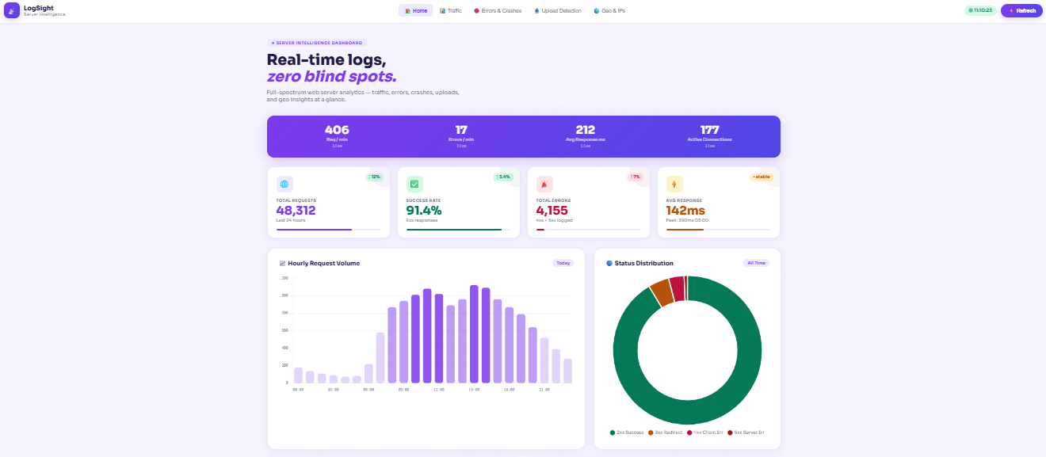
Introduction
Web servers generate large volumes of log data that record every user request, response status, IP address, and access time. Analyzing this log data helps organizations understand user behavior, detect security threats, and optimize system performance.
Traditional log analysis tools struggle to process large-scale datasets efficiently. To address this problem, Apache Spark, a distributed big data processing framework, can analyze massive log files quickly using in-memory computation.
This project focuses on building a web-based log analytics system that processes server logs and visualizes insights through interactive dashboards.
Applications
Cybersecurity threat detection
Website traffic monitoring
Performance optimization
User behavior analysis

Slide 5
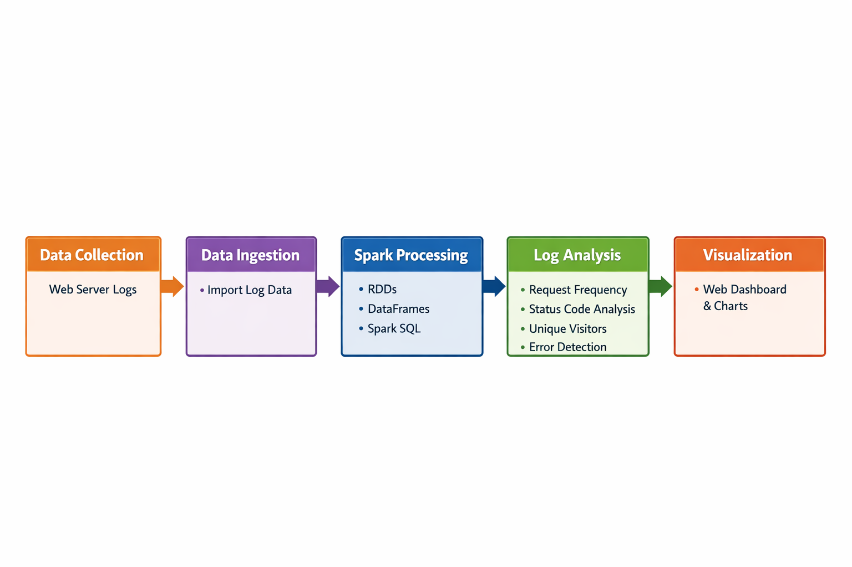
Proposed Method

Slide 6
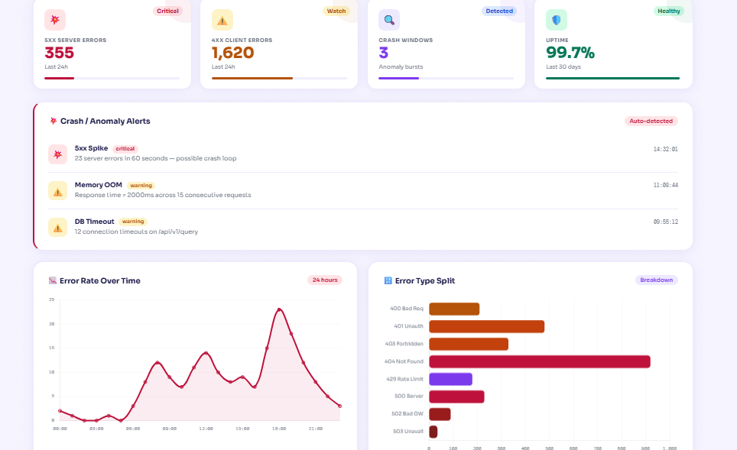
Objectives
The main objectives of this project are:
To design and develop a scalable web server log analysis system using big data technologies.
To preprocess and convert raw log data into structured format for efficient analysis.
To analyze web traffic patterns, user behavior, and server performance.
To detect errors, anomalies, and suspicious activities from log data.
To visualize analysis results using graphical dashboards for easy interpretation.

Slide 7
Module-wise Implementations
Module 1: Log Data Collection Collect web server log file
Module 2: Data Pre-processing Clean and filter log data. Convert raw logs into structured format.
Module 3: Data Processing (Apache Spark)Process large log data using Spark. Analyze traffic, status codes, and user activity.
Module 4: Visualization Dashboard Visualize results using charts and graphs. Display traffic trends and error analysis.
Module 5: Anomaly Detection Detect unusual traffic and suspicious IP Activity. Identify error patterns and server issues.es (Apache/Nginx).Store log data in HDFS or local storage.

Slide 8
Literature Survey
Paper Title | Reference Link | Drawback | Future Work
Large-Scale Web Log Analysis Using Hadoop | https://arxiv.org/abs/1709.03546 | High latency due to disk-based processing and lack of real-time analysis. | Can be extended using in-memory processing and real-time streaming frameworks.
Apache Spark for Big Data Processing | https://arxiv.org/abs/1802.00316 | Requires high memory resources and complex configuration. | Optimization techniques and cloud-based deployment can improve performance.
Web Usage Mining from Server Logs | https://ieeexplore.ieee.org/document/7488251 | Limited to historical data analysis and lacks real-time insights. | Integration with real-time log streams for dynamic behavior analysis.
Big Data Analytics for Log Data | https://www.sciencedirect.com/science/article/pii/S1877050917322094 | Scalability issues when handling extremely high-velocity data. | Adoption of distributed streaming platforms for continuous data ingestion.
Real-Time Log Analysis Using Distributed Systems | https://link.springer.com/article/10.1007/s00521-020-04762-8 | Complex system design and high computational cost. | Simplified architectures and intelligent anomaly detection methods.

Slide 9
Paper Title | Reference Link | Drawback | Future Work
Log Mining for Web Usage Analysis | https://ieeexplore.ieee.org/document/611314 | Limited ability to handle large-scale datasets efficiently. | Use of big data technologies like Spark and Hadoop for scalable analysis.
Big Data Processing Using MapReduce | https://research.google/pubs/pub62/ | Slow processing due to disk-based batch processing model. | Replacement with in-memory computing frameworks such as Apache Spark.
Scalable Log Processing with Apache Spark | https://spark.apache.org/research.html | High resource consumption in distributed clusters. | Development of optimized algorithms and lightweight processing pipelines.
Web Log Mining Using Data Mining Techniques | https://link.springer.com/chapter/10.1007/978-3-319-59888-8_7 | Limited support for real-time analytics and anomaly detection. | Integration with machine learning algorithms for predictive analysis..
Distributed Log Analysis for Web Applications | https://dl.acm.org/doi/10.1145/3183713.3196902 | Difficult system maintenance and complex distributed architecture. | Automated log monitoring systems with intelligent alert mechanisms.

Slide 10
Implementation
Tools and Technologies
Apache Spark for large-scale log data processing
Python (PySpark) for data preprocessing and analysis
React for interactive web dashboard
Node.js for backend server
Apache/Nginx web server log dataset
Recharts for data visualization
Dataset
The dataset consists of Apache/Nginx web server log files.
The log files contain information about user requests and server responses.
Example Log Entry:192.168.1.105 - - [01/Jan/2024:10:15:32 +0000] "GET /api/users HTTP/1.1" 200 1542
Log Fields
IP Address
Timestamp
HTTP Request
Status Code
Response Size
These log files are processed using Apache Spark to generate analytics such as traffic analysis, error detection, and performance monitoring.

Slide 11
Comparison and Discussion
Hadoop vs Spark processing time
Traditional log analysis vs Spark log analysis
Processing time vs Data size
Error detection comparison
Method | Processing Speed | Scalability | Real-time Analysis
Traditional Tools | Slow | Low | No
Hadoop | Medium | High | No
Apache Spark | Fast | High | Yes
Content:
Traditional log analysis tools process data slowly due to disk-based processing.
Hadoop MapReduce processes large data but has high latency.
Apache Spark uses in-memory computation, resulting in faster processing.
Spark significantly reduces processing time and improves performance.
Graphical results show Spark performs better for large-scale log analysis.

Slide 12
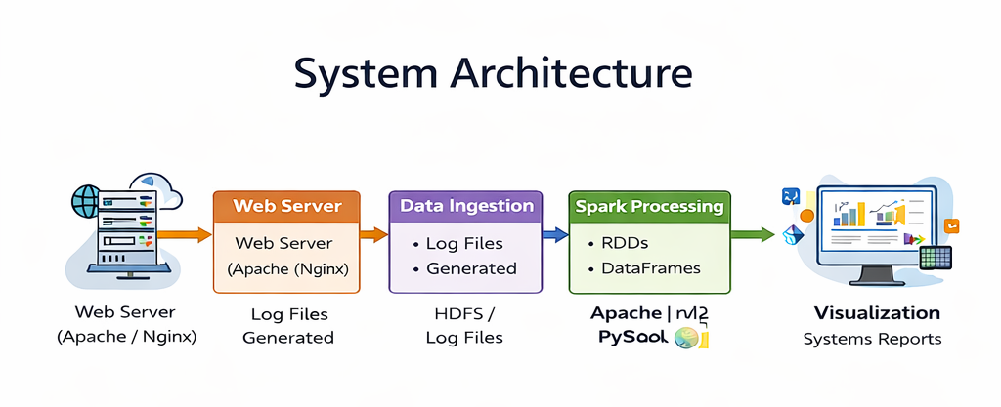

Slide 13
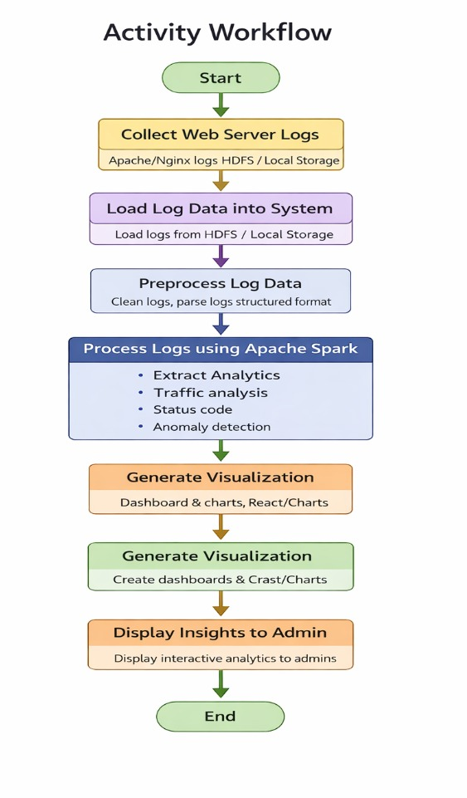

Slide 14
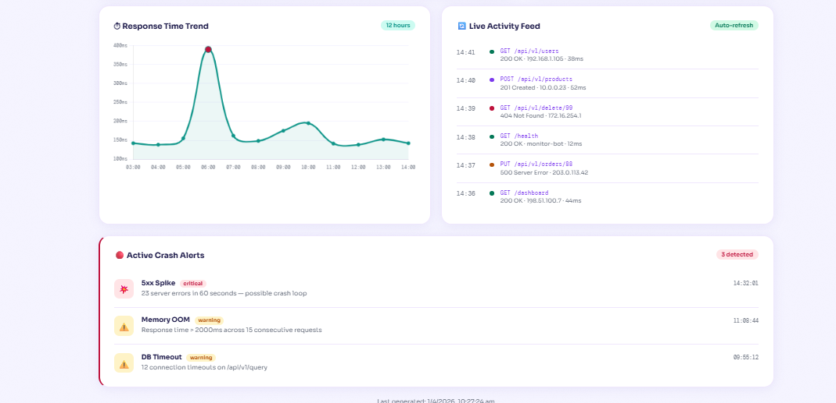
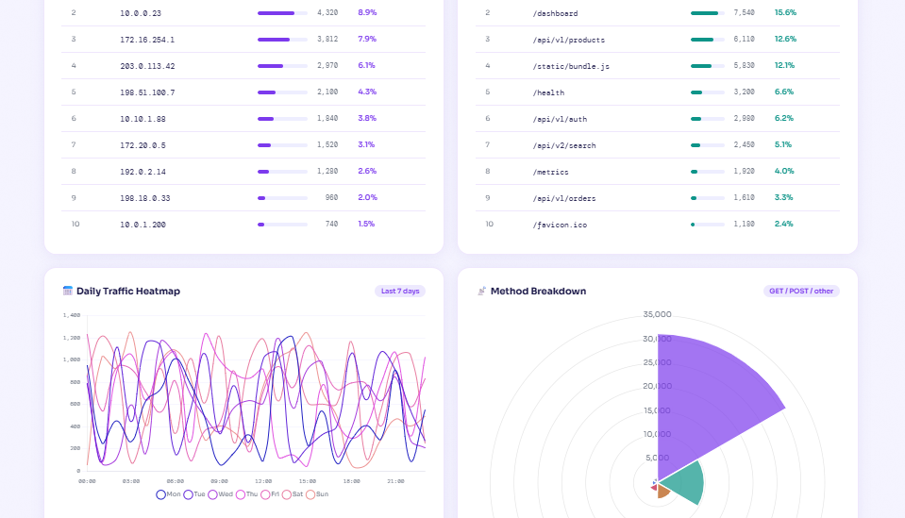
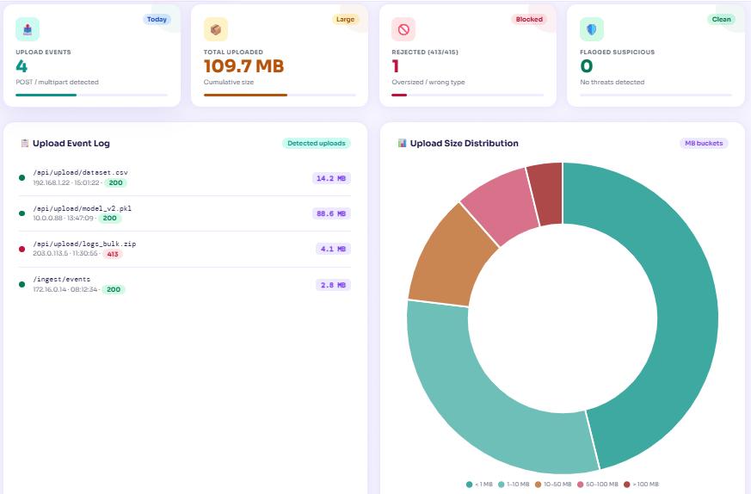
Result
Real-time log monitoring and performance metrics generated.
Traffic analysis identified top IPs, URLs, and data usage.
Error analysis detected server and client errors.
Upload detection monitored file uploads and suspicious activity.
Results visualized using interactive dashboard.

Slide 15
Conclusion
This project demonstrates efficient large-scale web server log analysis using Apache Spark.
Distributed and in-memory processing enables faster log data processing.
The system provides real-time insights through an interactive dashboard.
It also detects anomalies, error patterns, and traffic behavior.
The system helps in server monitoring, performance analysis, and security analysis.
Future Work
Implement real-time log analysis using Spark Streaming.
Integrate with security monitoring and alert systems.
Apply machine learning for advanced anomaly detection.
Deploy the system on cloud platforms for scalability.

Slide 16
THANK YOU

